Slide 1

Cosc 1352 Final Project Presentation
By: Nick Belbas and Brian Davis

Slide 2
Overview
We created this project as a way to implement many of the things we learned this past semester into one program
This project monitors the current sound level around it and can automatically send a tweet once the sound level has reached a new record
We currently use a small microphone connected to GPIO to monitor sound level and a USB webcam to take photos to tweet
We implemented the use of twitter in our project so when we automatically took a photo it would then post it to twitter.

Slide 3
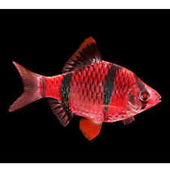
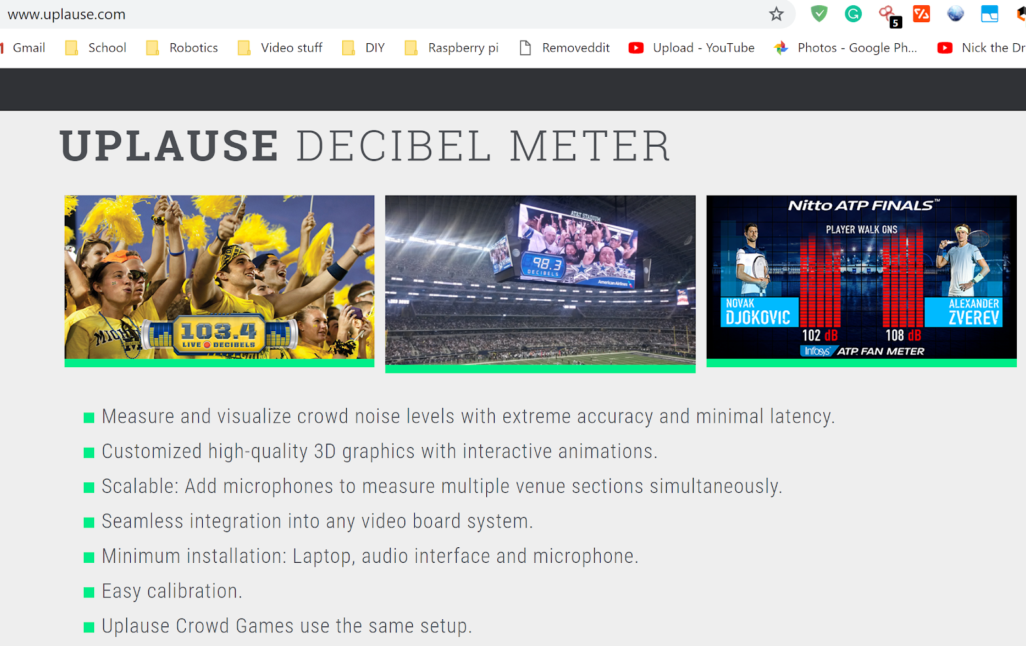
Background

Slide 4
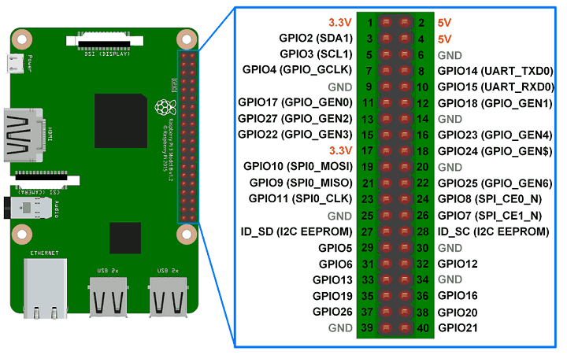
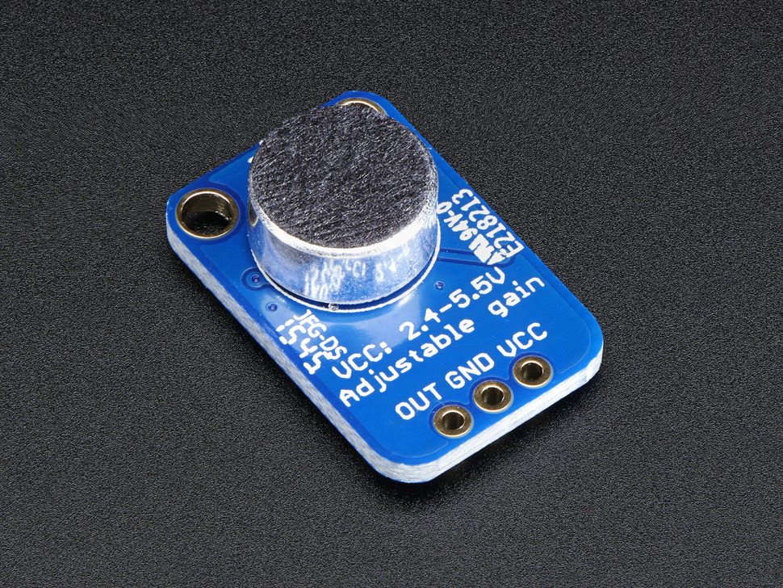
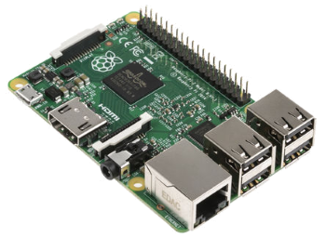
GPIO/ADC

Slide 5
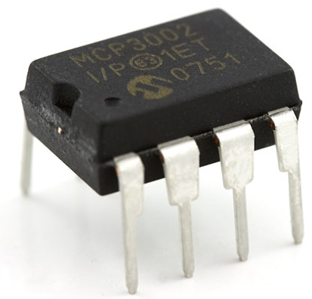

GPIO/ADC
?

Slide 6
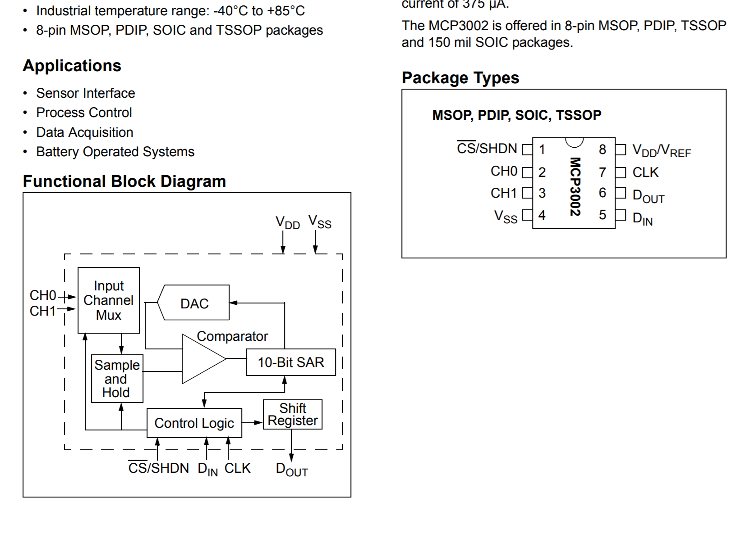
GPIO/ADC

Slide 7
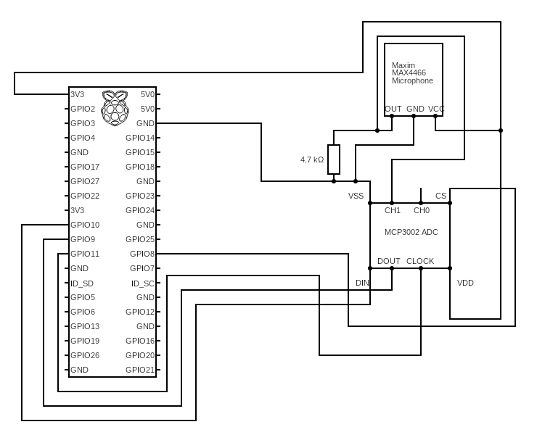
GPIO/ADC
def read_adc(adc_ch, vref = 3.3):
# ----------------------------------------
# This read_adc method created by Sparkfun
# ----------------------------------------
# Make sure ADC channel is 0 or 1
if adc_ch != 0:
adc_ch = 1
# Construct SPI message
# First bit (Start): Logic high (1)
# Second bit (SGL/DIFF): 1 to select single mode
# Third bit (ODD/SIGN): Select channel (0 or 1)
# Fourth bit (MSFB): 0 for LSB first
# Next 12 bits: 0 (don't care)
msg = 0b11
msg = ((msg << 1) + adc_ch) << 5
msg = [msg, 0b00000000]
reply = spi.xfer2(msg)
# Construct single integer out of the reply (2 bytes)
adc = 0
for n in reply:
adc = (adc << 8) + n
# Last bit (0) is not part of ADC value, shift to remove it
adc = adc >> 1
# Calculate voltage form ADC value
voltage = (vref * adc) / 1024
return voltage
import spidev
spi_ch = 1
spi = spidev.SpiDev(0, spi_ch)
spi.max_speed_hz = 1200000 #1.2mbps
soundLevel = read_adc(0)

Slide 8
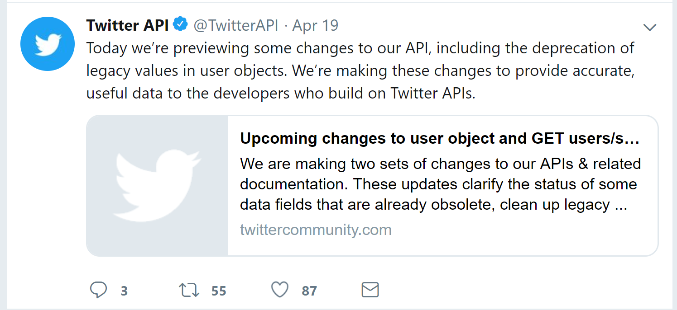
Twitter API
Proved to be one of the most difficult parts

Slide 9
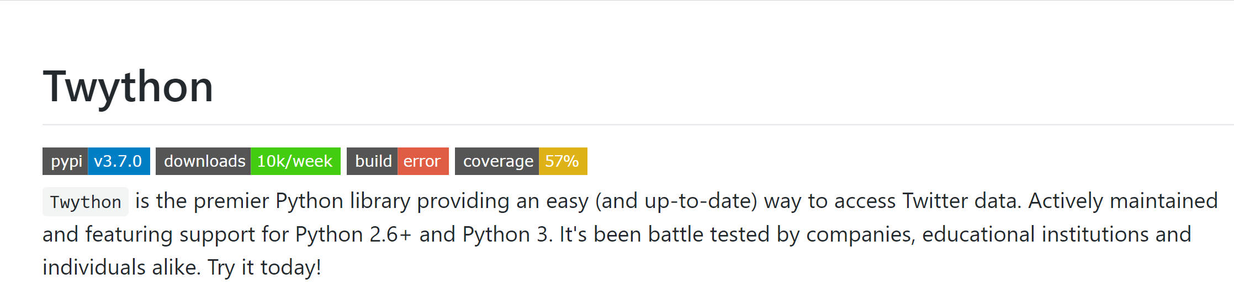
Twitter API

Slide 10
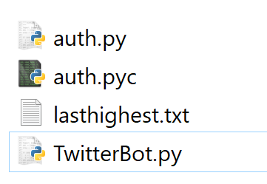
Twitter API
from twython import Twython
from auth import (consumer_key,consumer_secret,access_token,access_token_secret)
twitter=Twython(consumer_key,consumer_secret,access_token,access_token_secret)
--------------------------------------------------------------------
consumer_key = 'xwc9DYULHI7FvXXXXXXXXXXXX'
consumer_secret = 'UFhn3NnNazDT2QfRwMsW4OR8ifpXXXXXXXXXXXXXXXXXXXXXXXX'
access_token = '752540XXXXXXXXXXXX-2t5WgllkfAXXXXXXXXXXXXXXXXXXXXX'
access_token_secret = '23GkGYUMrNYP9apapQAt0XXXXXXXXXXXXXXXXXXXXXXXX'

Slide 11
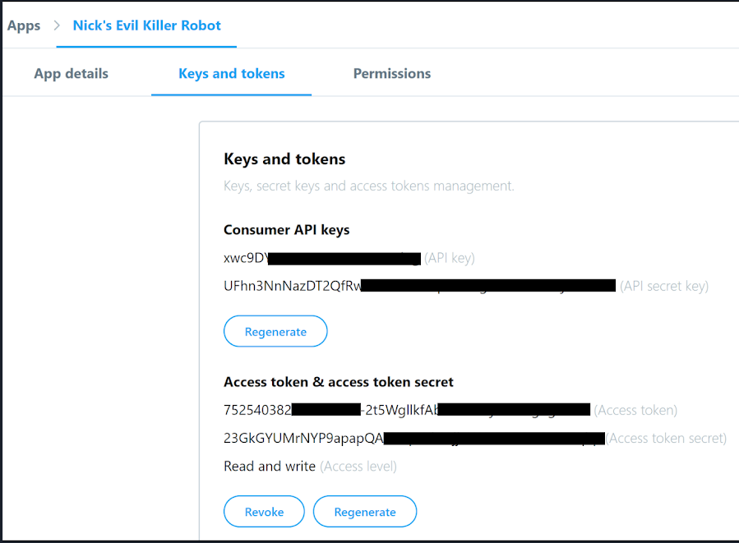
Twitter API

Slide 12
Twitter API
huskyCheers=["Dawgs Up!","Go Huskies!"]
otherTeam="otherBois"
otherTeam=str(raw_input("Please enter opposing team:"))
print "Tweeting..."
print "\n"
cheer=huskyCheers[random.randint(0,1)]
currentDT = datetime.datetime.now()
message = "*THIS IS AN AUTOMATED TWEET* \nA new crowd noise level was set tonight at HBU Huskies Football stadium during the game against {} at {} on {}! {}".format(otherTeam,currentDT.strftime("%I:%M %p"),currentDT.strftime("%a, %b %d, %Y"),cheer)
twitter.update_status(status=message)
print "tweet successfully sent”

Slide 13
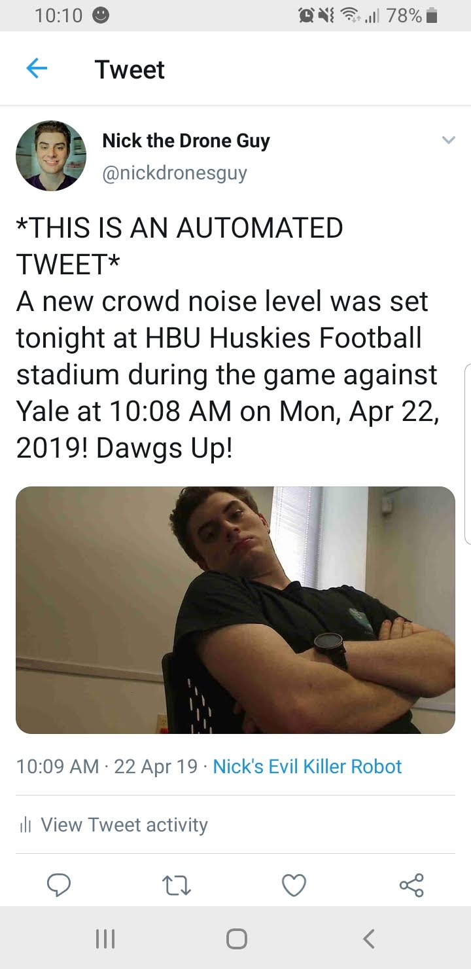
Twitter API

Slide 14
GUI
Tkinter, though it is supposed to be simple to use, was tough to understand the explanations of how different commands are used.
This made it tough to use the different GUI commands because we could not find similar circumstances to our own so that we could adapt their code to our needs.

Slide 15
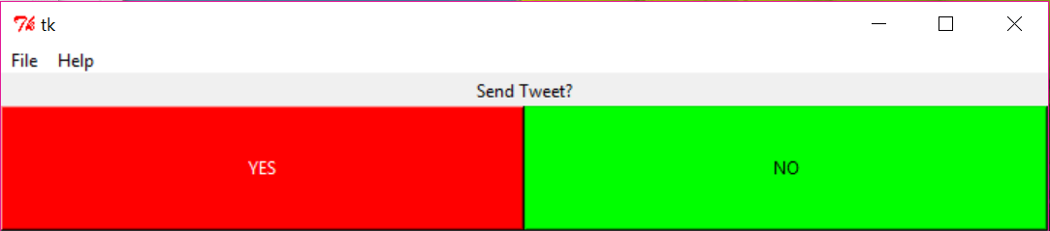
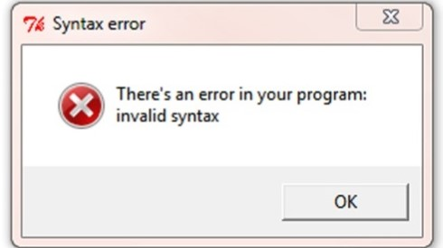
GUI
window.mainloop()
b1 = Button(self.master, text = "YES", bg = 'red', fg = 'white', width = 50, height = 5, command = self.sendTweet)

Slide 16
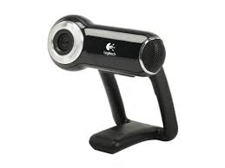
Camera
We used a Logitech Pro 9000 webcam for the purposes of taking pictures. This allowed for easy picture taking and use of pictures.
os.system('fswebcam -r 1280x720 --no-banner image.jpg')
os.system() allows commands to be run in linux shell
Command takes photo in 720p and saves to current directory
response = twitter.upload_media(media=image)
The response is a temporary placeholder for the image taken
This placeholder is used later to assign it an ID number

Slide 17
Camera
media_id = [response['media_id']]
The ID is then attached to the image from the twitter server
This prepares it to be uploaded to twitter in a format it can read
twitter.update_status(status=message,media_ids=media_id)
Command sends tweet and attaches media ID, thus attaching picture to tweet

Slide 18
Conclusion
Though we may have had much adversity with the programming and implementation of the different aspects of our project, we were able to figure out and resolve each problem. The largest problem we encountered was our microphone not always reading and outputting correct values. This highly impacted the amount of time needed to troubleshoot the project.
Our project can be used in football games to automatically send out a picture of the game when there in loud cheering. It is meant to read the analog values outputted by the microphone and determine whether it is supposed to act based on the last highest value read.
If it reads a higher value, it then prompts the user whether or not to send out a tweet about the game.
If the user says no, it closes the GUI and tries again. If it reads yes, the program automatically takes a picture with the camera connected to the RPi and sends a tweet with the different teams, the scores, and a randomly generated cheer.
In the future we plan to include code that receives the current score and teams playing to make it completely autonomous.

